Slide 1
Introducing Inheritance
Inheritance is the mechanism by which one class can inherit the properties of another class.
Inheritance allows a hierarchy of classes to be built, moving from most general to the most specific.
When one class is inherited by another, the class that is inherited is called the base class.
The inheriting class is called the derived class.

Slide 2
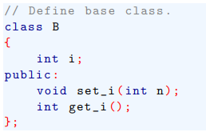
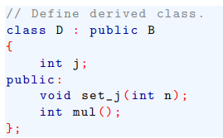
Introducing Inheritance
To start, here is the declaration for the base class:
Using this base class, here is a derived class that inherit its:

Slide 3
Introducing Inheritance
The keyword public tells the compiler that B will be inherited such that all public elements of the base class will also be public elements of the derived class.
However, all private elements of the base class remain private to it and are not directly accessible by the derived class.

Slide 4
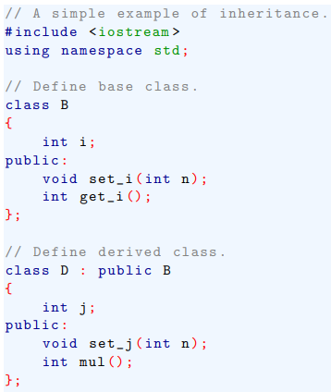
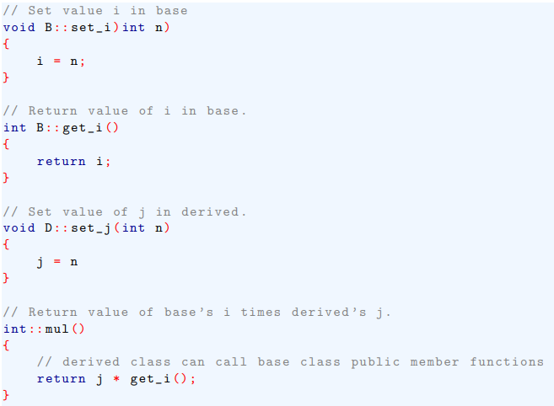
Introducing Inheritance

Slide 5
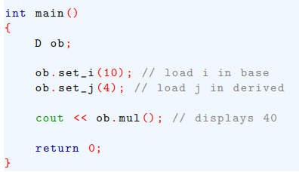

Introducing Inheritance
This program shows the encapsulation properties.

Slide 6
Introducing Inheritance
Here access-specifier is one of the following three keywords: public, private or protected.

Slide 7
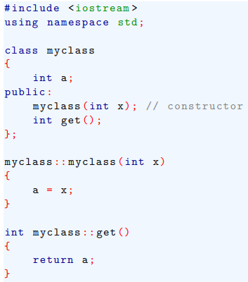
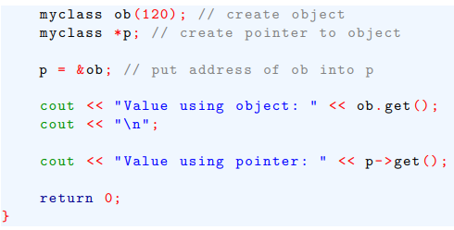
Object Pointers
Here is a simple example that uses an object pointers.

Slide 8
In-Line Functions
In C++, it is possible to define functions that are not actually called but, rather, expanded in line, at the point of each call.
The advantage if in-line functions is that they have no overhead associated with the function call and return mechanism.
This means that in-line functions can be much faster than normal functions.
The machine instructions that generate the function call and return take time a function is called.

Slide 9
In-Line Functions
The disadvantage of in-line function is that if they are too large and called too often, program grows larger.
For this reason, in general only short functions are declared as in-line functions.

Slide 10

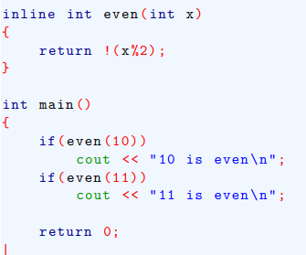
In-Line Functions
For example, this short program shows how to declare an in-line function:

Slide 11
In-Line Functions
The important feature of using inline: an in-line function must be defined before it is first called.

Slide 12
Automatic In-Lining
If a member function’s definition is short enough, the definition can be included inside the class declaration.
Doing so causes the function to automatically become in-line function, if possible.
When a function is defined within a class declaration, the inline keyword is no longer necessary.

Slide 13

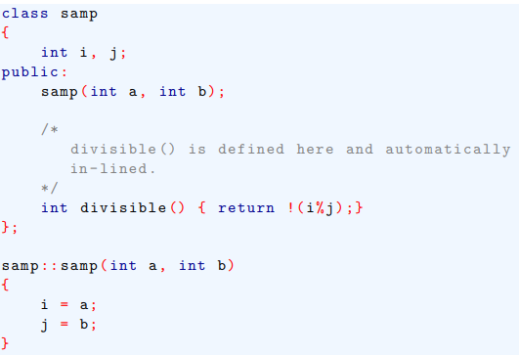
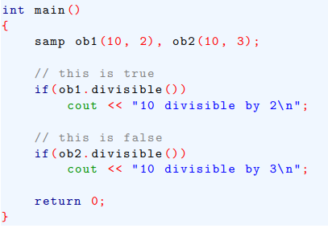
Automatic In-Lining
For example,

Slide 14
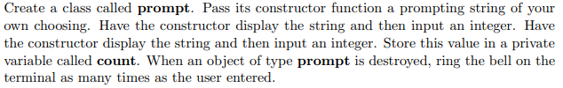

Lab Problem:

